Slide 1
Submission Outcome Prediction
Objective
Predict a submission will end as Bound (1) or Not Bound (0)
Deliver a model + interpretability insights for integration

Slide 2
Features & Target Variable Overview
List all features with brief description:
LOB (line of business) – [‘GL‘, 'PD‘, 'CL‘, 'NT' ,‘TL‘ ,'OA‘ etc.]
Broker ID – (broker’s unique id)
hit ratio broker – ( total number of bound policies of broker/ total number of submission by broker )
Days Before Effective Date – ( effective date - submission date )
Premium Size – (Total insurance premium amount)
Broker Commission – (Payment to broker, usually % of premium)
Underwriter Turnaround Time - ( quote issued date – submission created date )
New vs Renewal - (Types of policy )
Historical Submission Volume – (count of submission done in last 90 days by broker)
Historical Bind Ratio - (total number of bound policies of broker/ total number of submission by broker in last 90 days by broker)
Target Variable :
1 = Bound (policy issued)
0 = Not Bound (declined, withdrawn, unquoted)

Slide 3
Preprocessing data & model training
Data extraction :
Extracted required data from NECSpecialty_EIReporting and Guardian_EIReporting datasbase , query used to featch data is shared in SQL query.docx file
Preprocessing and model training:
Preprocessing overview
Data cleaning:
Handled missing values in broker commission based on target class
Convert negative days before effective date to positive
Expanded multi-valued LOB entries into separate rows
Feature Engineering:
Transform categorical features like (LOB , New VS Renewal ) by one-Hot Encoded
Numerical features transformed by using StandardScaler
Passed some features without transformation (hit ratio broker , historical bind ratio )
Model training overview
Split data in 70 % for training and 30 % for testing
Balance target class of training data by smote to improve model performance.
Trained random forest ,XGBoost model and evaluate their performance by confusion matrix ,classification report and ROC-AUC
Perform stratified K fold cross validation to check model performs on different splits of the data.
Trained a pipeline with a preprocessor and a model and saved it as .pkl file

Slide 4
Test data Performance Both models achieved ~ 99.9% accuracy Random Forest: Confusion Matrix: [[29385 18] [ 103 8520]] ROC-AUC Score for random forest model : 0.9937 XGBoost: Confusion Matrix: [[29381 22] [ 96 8527]] ROC-AUC Score: 0.9968 Classification Reports: Precision, Recall, and F1-score were all very high (≥0.99) for both classes
Stratified 5-Fold Cross-Validation
To ensure model generalization, we used Stratified K-Fold CV:
Random Forest:
Mean Accuracy: 99.68%
Accuracy Range: 99.62% – 99.72%
Std. Deviation: ±0.00047
XGBoost:
Mean Accuracy: 99.70%
Accuracy Range: 99.65% – 99.76%
Std. Deviation: ±0.00047
These results indicate that both models are highly stable and consistently performant across different subsets of data.

Slide 5
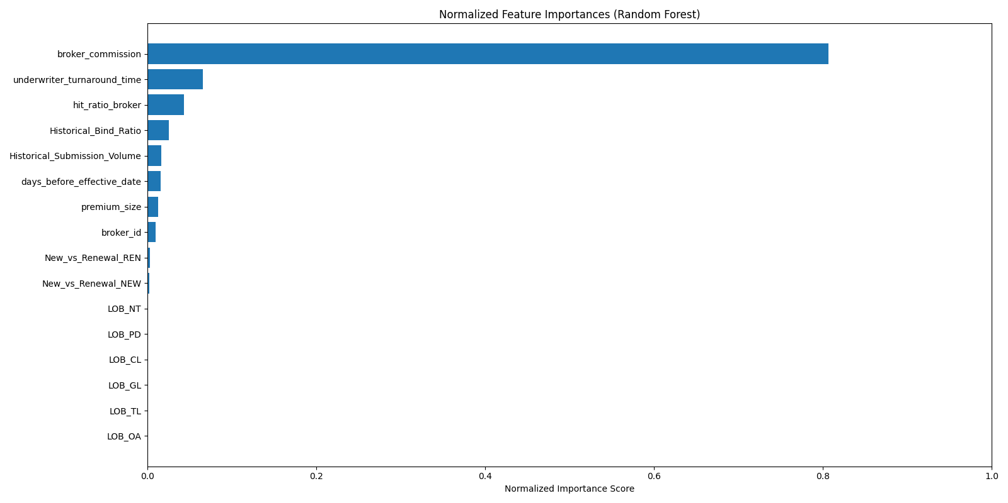
Feature importance plot for random forest model
Broker commission emerged as the most important feature driving the prediction of submission outcomes
It has a significantly higher feature importance value compared to all other features
Other key contributors include:
Underwriter turnaround time
Hit ratio of broker
Historical bind ratio
Historical submission volume
Days before effective date
The model strongly relies on broker related features for accurate prediction

Slide 6
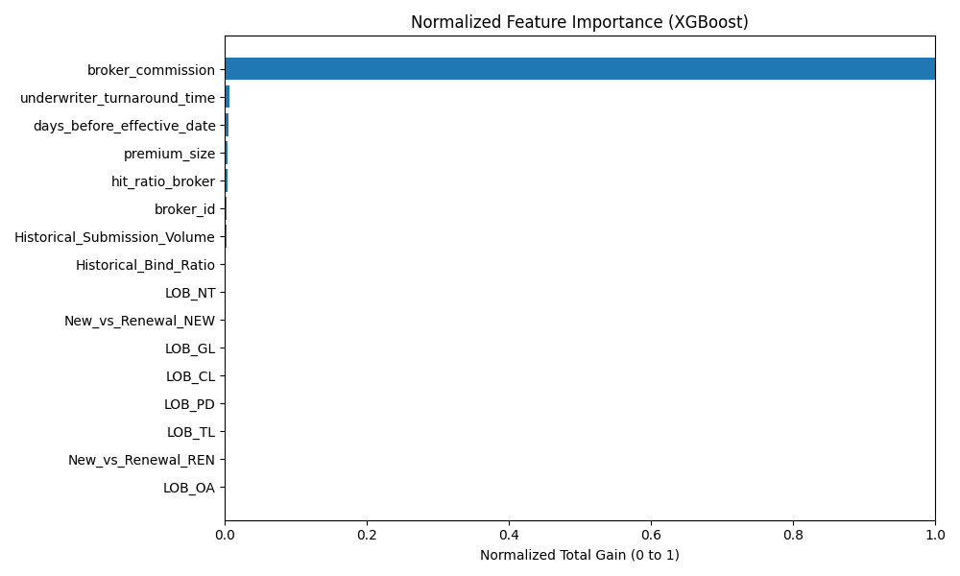
Feature importance for XGBoost model
Just like in the Random Forest model, Broker Commission is the most influential feature in predicting submission outcomes.
It has a dominant importance score, far exceeding all other features.
Additional features that contribute to predictions include:
Underwriter Turnaround Time
Days Before Effective Date
Premium Size
Compared to Broker Commission, these features show relatively low importance, indicating that the model heavily prioritizes commission-related data in its decisions.

Slide 7
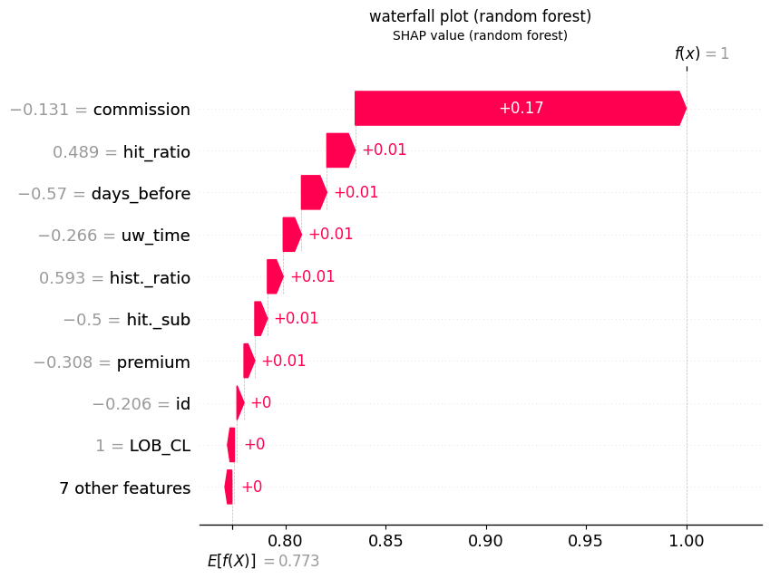
Waterfall plot for random forest model
The shap values expain how much each feature contributed to shift the models output from the base value
The following features were found to have the strongest impact on the model’s predictions Broker commission ,hit ratio of broker ,days before effective date, underwriter turnaround time ,premium and historical submission volume
Among all, Broker Commission stands out with the highest SHAP value, indicating it significantly influences whether a submission is predicted to bind.
The base value (E[f(x)]) represents the model’s expected output before any feature values are considered is 0.773
Broker Commission was the dominant factor, contributing over 85% of the total impact needed to reach a prediction of "Bound".
Other features such as Hit Ratio, Premium, and Submission Timing Metrics contributed incrementally, but had much less influence.
This illustrates the model's strong reliance on commission-related signals, affirming its critical role in driving submission outcomes.

Slide 8
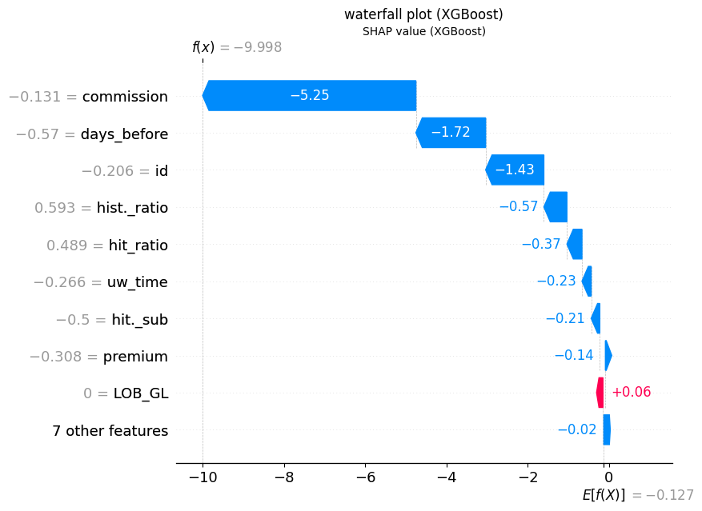
Waterfall plot for XGBoost model
Broker Commission is the dominant feature, contributing over half of the total SHAP impact and strongly pushing the model to predict
Other features like Days Before Effective Date and Broker ID also have significant negative effects, reinforcing the rejection prediction.
Historical bind ratio, hit ratio, and submission volume features contribute moderate negative influence, indicating the model considers broker history as well.
This analysis highlights the model’s reliance on commission and broker-related metrics to differentiate binding outcomes.

